Slide 1

Living Healthy DAPP (LHD)
The Group
Aaron Packard, john Millar, Richard Henderson

Slide 2
proposal
Functionality
dApp capture user data
Height, weight, gender, age, etc.
AJAX
Integration between dApp and Python
IPFS capture images
Tracking results and verification
Python calculates user's health status
BMI, ideal weight, time to reach goal, etc.
Solidity creates a blockchain contract
Mint coins, track progress, pay-out, etc.
Create a dApp that companies can use to motivate their employees to make healthy choices. Through this process, companies mint their own coins to entice their employees to complete “healthy” tasks and challenges. Those employees are then able to cash out their coins from real money.

Slide 3
unique
Benefits:
Healthier employees are happier and more productive employees
Healthier employees cost less in insurance premiums and yearly costs
Employees are more likely to patriciate if there is also a financial benefit to them
We can create long term habit’s by manipulating short term habits
Compelling: Most company health programs are limited in the types of challenges and rewards are capped. LHD allows changes to be created on the fly through Solidity contracts and the coins available are unlimited.
Transparent: Since we’re on a blockchain, the challenges are open for your friends to see and motivate you, your employer to track the benefit to the company and co-workers to challenge you.
Flexible: Goals and challenges are controlled by the employee instead of pre-configured.

Slide 4
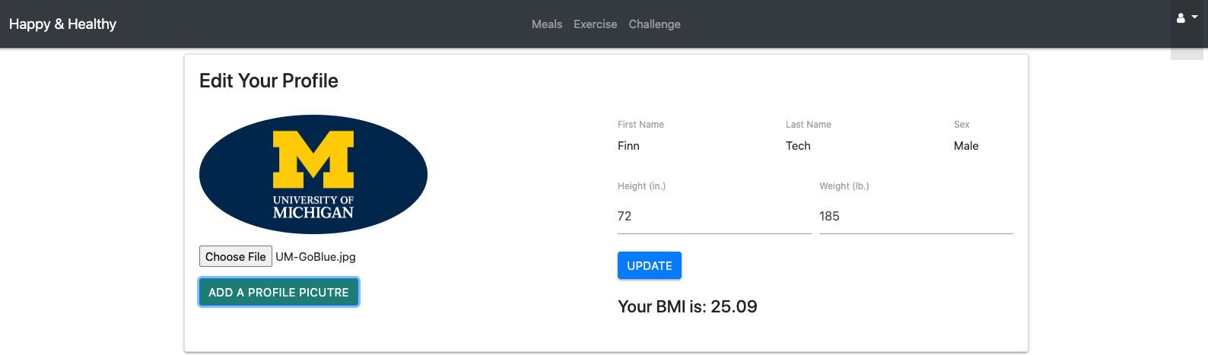
DAPP
Capture current health attributes
Capture daily calorie information
Capture challenge information
Goal, wager, start, tracker
Utilize IPFS to capture images

Slide 5
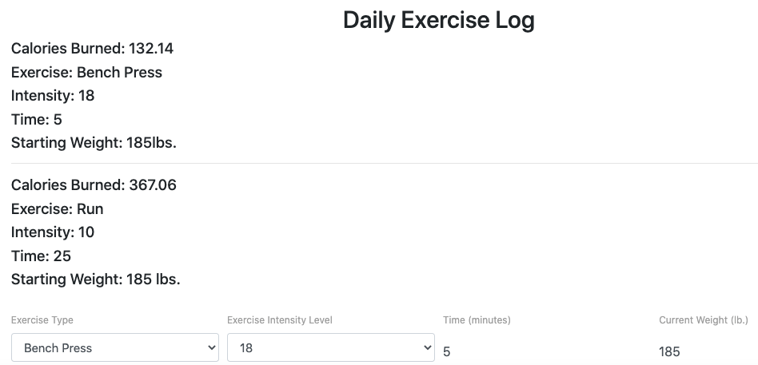
Python functions

Slide 6
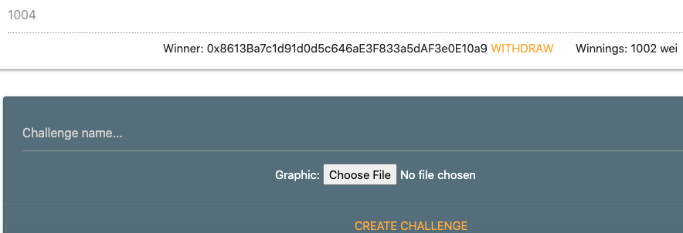
Solidity contracts
Crowdsale.sol
HealthLifeCoin.sol
ICO.sol
UserContract.sol
UserInformatin.sol
migration.sol

Slide 7
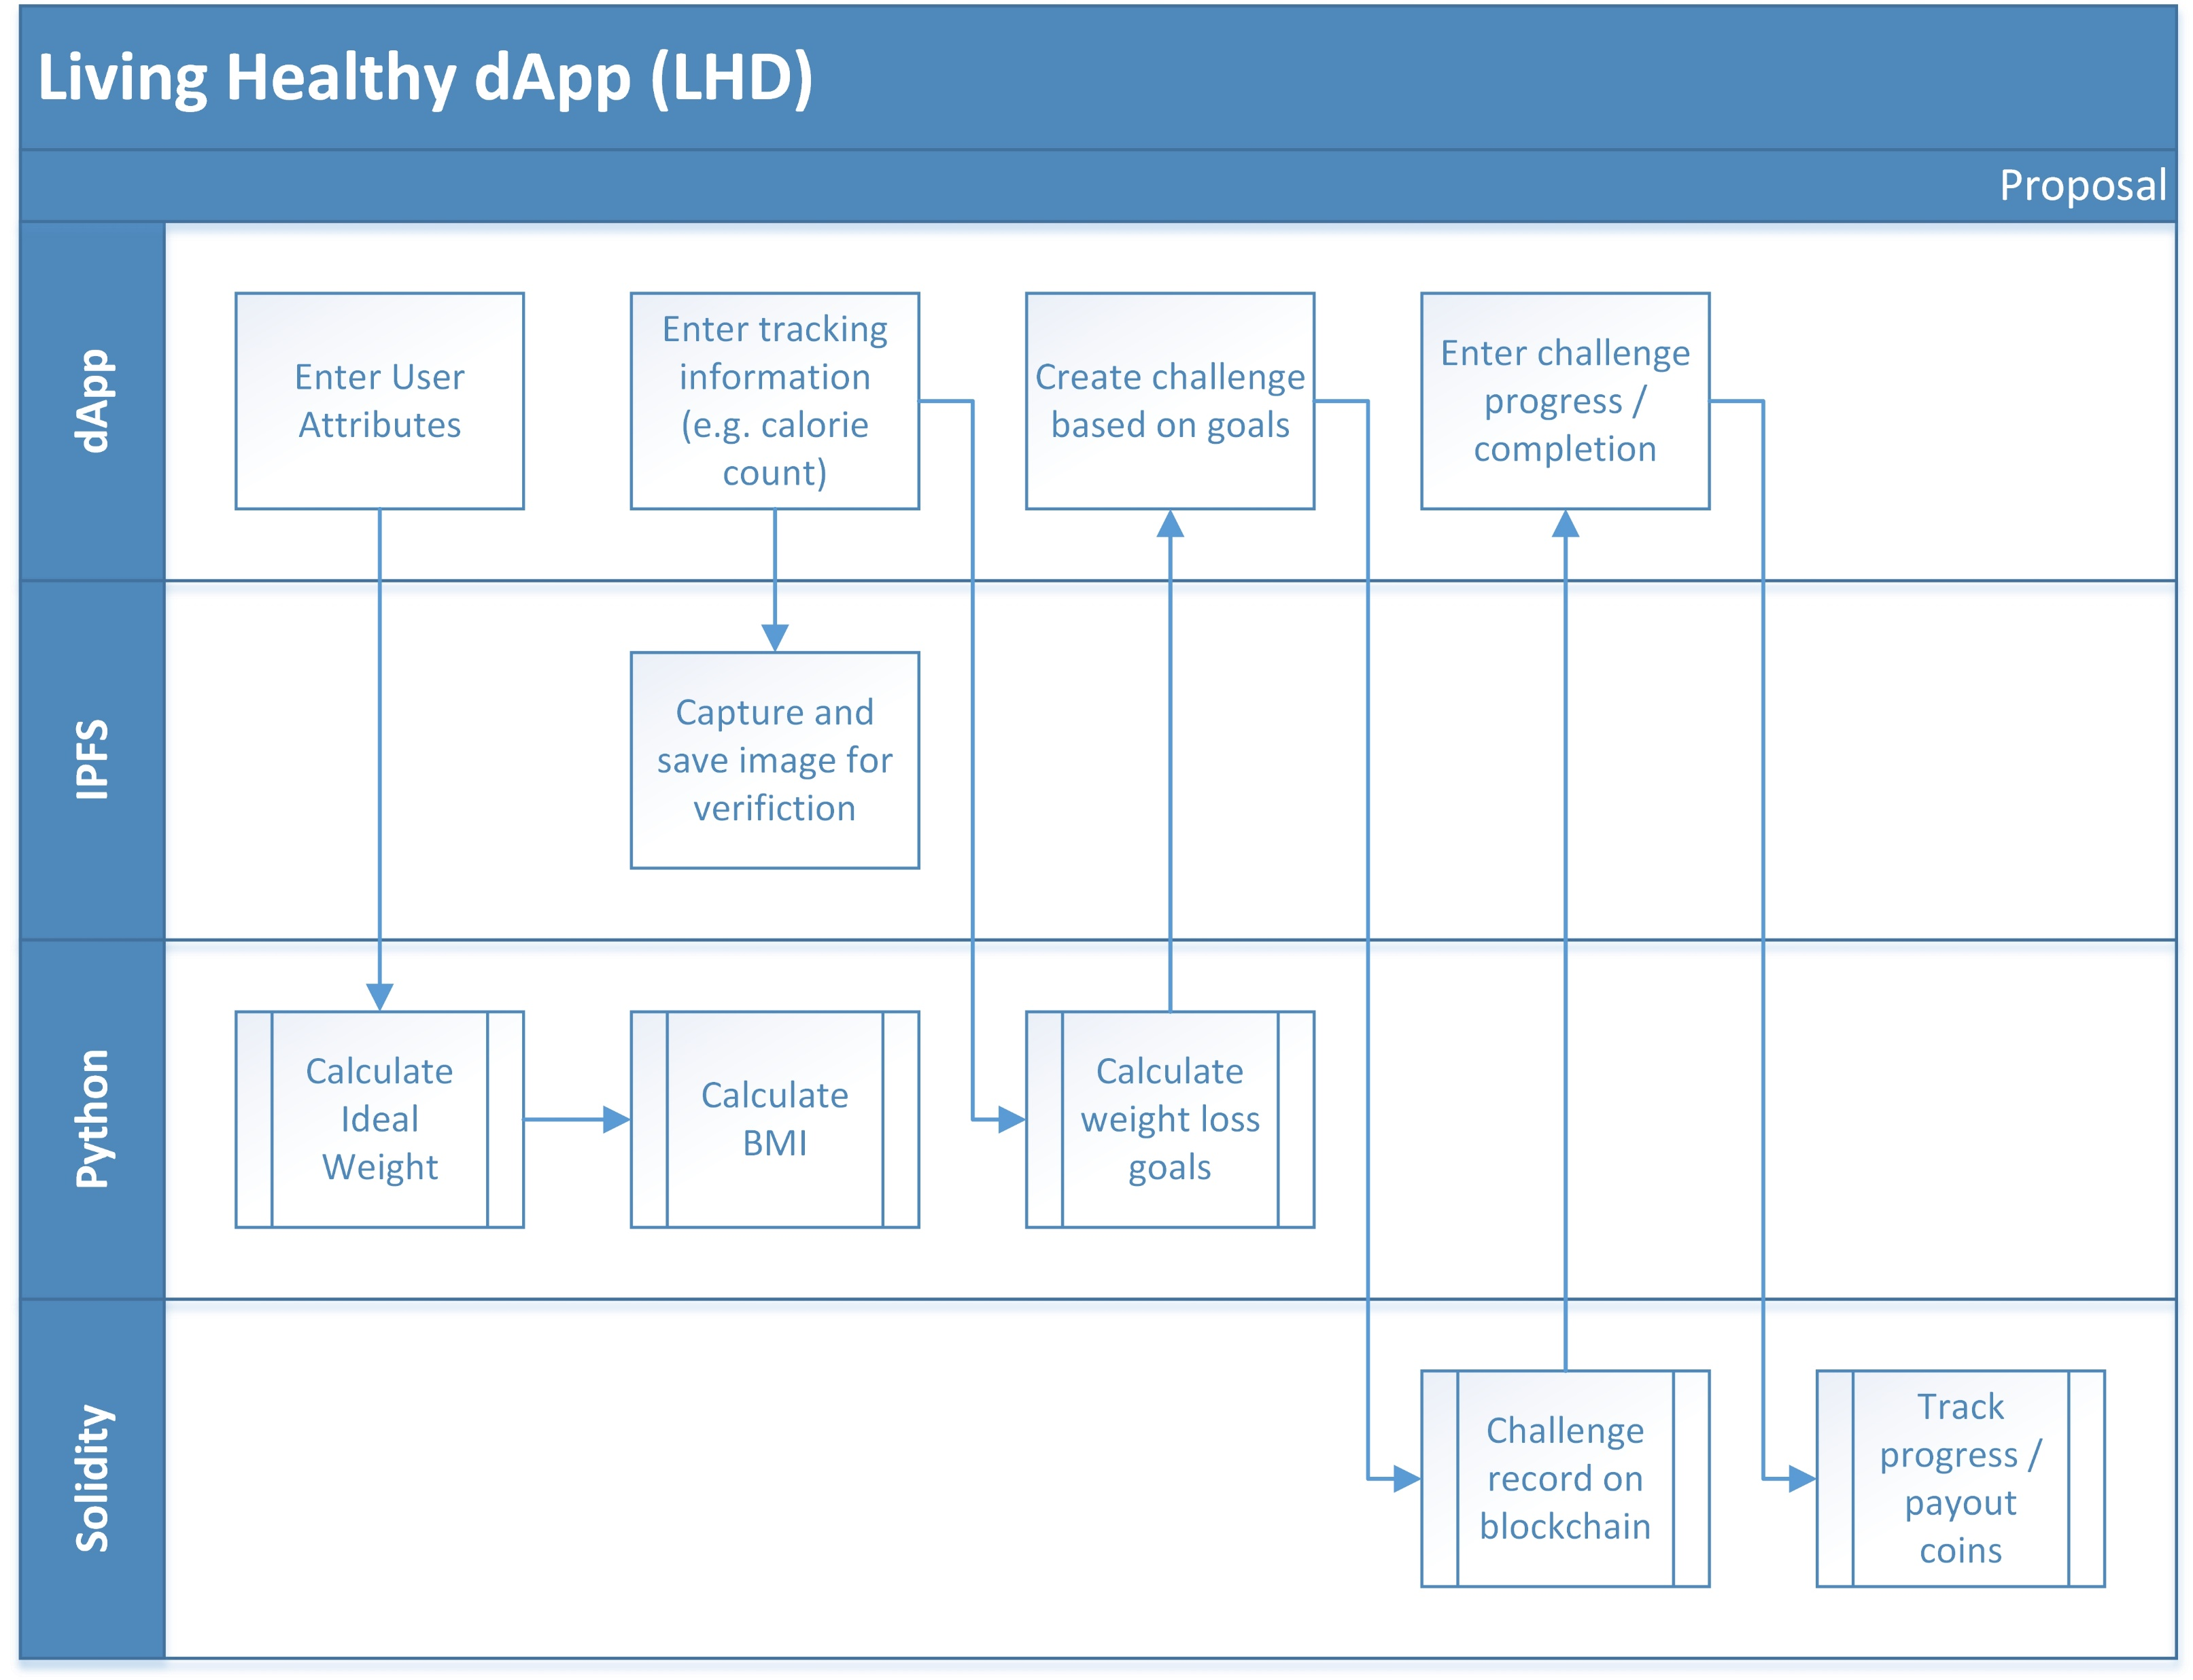
Process flow
dApp
Connects to Python to run calculations
Connects to IPFS to store images
Connects to Solidity to run contracts and add to blockchain
AJAX for integration

Slide 8
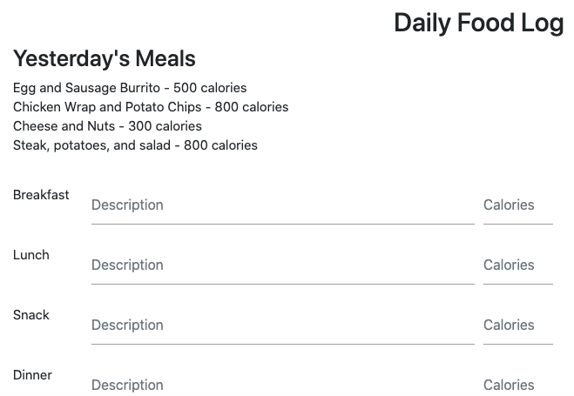
Use cases
Employee enters current health attributes
Employee enters daily calorie information
Employee starts, tracks and completes challenges to earn coins

